Slide 1
Prediction and Analysis of Gold Price (Minor Project Report) 2022-23
Submitted By
Saurabh Gupta
M.Sc. 3rd SEM
Roll No: - 23321078

Slide 2
Introduction
Gold has been highly valued by humans for thousands of years, dating back to ancient civilizations such as the Egyptians and the Greeks. It has been used as currency, jewelry, and even as a symbol of power and wealth
Gold prices are influenced by a variety of factors, including supply and demand, global economic conditions, interest rates, and inflation. As an investment, gold has been known to be volatile, with prices often fluctuating sharply in response to economic and political events.
Time series analysis is a statistical technique used to analyze data that changes over time. It can be used to forecast future values based on historical data. In the case of gold price prediction, time series analysis can be used to identify patterns and trends in gold prices over time, and to forecast future prices based on these patterns.

Slide 3
Motivation
In modern times, gold is widely traded in financial markets as a commodity, and its price is subject to supply and demand forces, geopolitical tensions, and global economic trends.
Investors and financial institutions alike are interested in predicting the price of gold because it is a valuable asset that can provide a hedge against inflation and economic instability. As a safe haven asset, gold has historically performed well in times of economic downturns or political unrest, making it an attractive investment for those seeking stability and long-term growth.
Moreover, the price of gold has a significant impact on the global economy, as it is often used as a benchmark for the value of currencies and other commodities. In addition, gold is widely used in jewelry and other industries, making it an important component of global trade.
Given its historical significance and its current role in the global economy, there is a strong motivation for predicting the price of gold with accuracy.

Slide 4
Objective
1-To forecast the future prices of gold: The primary objective of gold price prediction is to forecast the future prices of gold using historical data and relevant predictors. This can help investors and businesses make informed decisions about buying and selling gold.
2-To identify patterns and trends in the gold market: By analysing historical data, a gold price prediction project can identify patterns and trends in the gold market. This can help investors and businesses understand the factors that influence the price of gold and make more informed decisions.
3-To develop a predictive model for gold prices: A gold price prediction project can involve the development of a predictive model for gold prices. This can be done using time-series analysis or other statistical techniques.
4-To evaluate the accuracy of gold price predictions: Another objective of a gold price prediction project is to evaluate the accuracy of the predictions made by the model. This can be done by comparing the predicted prices with the actual prices over a given time period.

Slide 5
Data Descriptions-
This dataset contains information about daily gold prices, specifically the daily opening, closing, high and low prices. In addition, changes in the amount and percentage of gold traded were recorded.
• Date: Recording date.
• Price: It is close price which can be considered as final price.
• Open: Price at the time of market opening at that day.
• High: Highest price during whole day.
• Low: Lowest price during whole day.
• Volume: Traded volume.
• Chg: % Change from previous price.
Date | Price | Open | High | Low | Volume | Chg%
01/01/2014 | 29542 | 29435 | 29598 | 29340 | 2930 | 0.25
02/01/2014 | 29975 | 29678 | 30050 | 29678 | 3140 | 1.47
03/01/2014 | 29727 | 30031 | 30125 | 29539 | 3050 | -0.83
04/01/2014 | 29279 | 29279 | 29279 | 29279 | 0 | -1.51
06/01/2014 | 29119 | 29300 | 29395 | 29051 | 24380 | -0.55
07/01/2014 | 28959 | 29130 | 29195 | 28912 | 18710 | -0.55
08/01/2014 | 28934 | 28916 | 29029 | 28820 | 18140 | -0.09
09/01/2014 | 28997 | 28990 | 29053 | 28865 | 15130 | 0.22
10/01/2014 | 29169 | 29030 | 29198 | 28960 | 15810 | 0.59

Slide 6
Methodology
Data Collection: The first step in the methodology is to collect the historical data of the gold price. The data can be collected from various sources such as Yahoo Finance, Google Finance, and the World Gold Council.
Data Pre-processing: The collected data needs to be pre-processed before it can be used for analysis. The data pre-processing involves cleaning the data, imputing missing values, transforming the data, and scaling the data. The data should also be checked for any outliers and removed if necessary.
Data Visualization: The pre-processed data needs to be visualized to get a better understanding of the trends and patterns in the data. Various time series plots can be used to visualize the data, such as line plots, scatter plots, and box plots.
Time Series Analysis: After visualizing the data, the next step is to perform time series analysis. The analysis involves decomposing the time series into its trend, seasonal, and residual components. The time series model can be selected based on the characteristics of the decomposed components.
Model Selection: There are various time series models that can be used to predict the gold price, such as ARIMA, SARIMA, and Prophet. The model can be selected based on the accuracy of the model, and the complexity of the model.

Slide 7
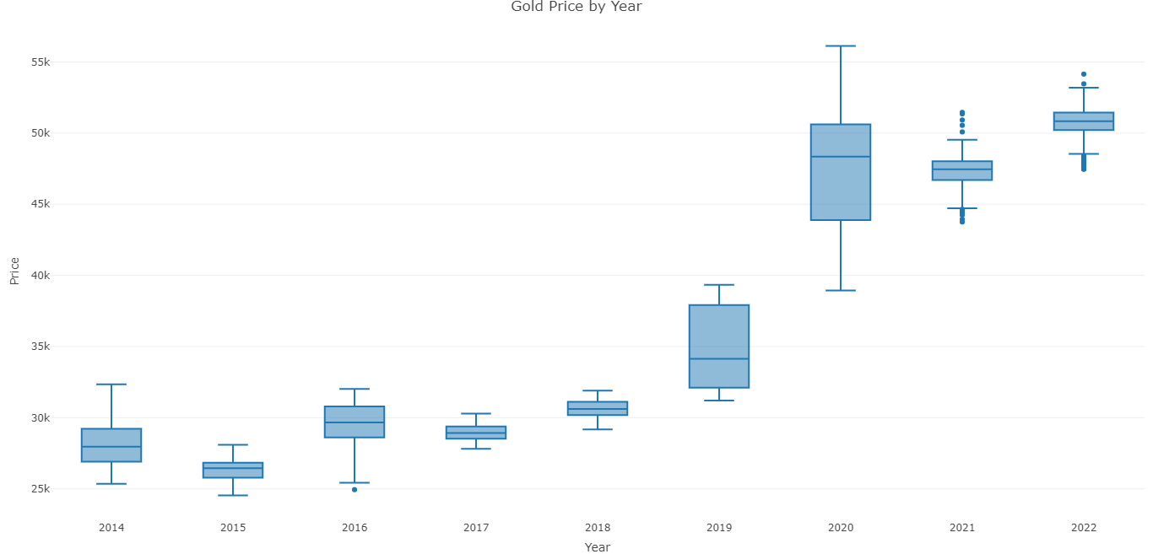
Empirical Investigation
The given boxplot of gold prices suggests that the year 2020 had the highest variation in gold prices, while the years 2017 and 2018 had the least variation. This can be seen by comparing the heights of the boxes for each year, which represent the range of gold prices, and by looking at the length of the whiskers, which represent the variability in the data.
The high variation in gold prices in 2020 may be attributed to the impact of the COVID-19 pandemic, which disrupted global markets and caused significant economic uncertainty. The fluctuating demand and supply of gold, combined with changes in the global economy, likely contributed to the higher range of gold prices in 2020.
On the other hand, the lower variation in gold prices in 2017 and 2018 may be attributed to more stable market conditions during those years. During these years, there may have been less economic and political instability, leading to a more consistent demand and supply of gold.

Slide 8
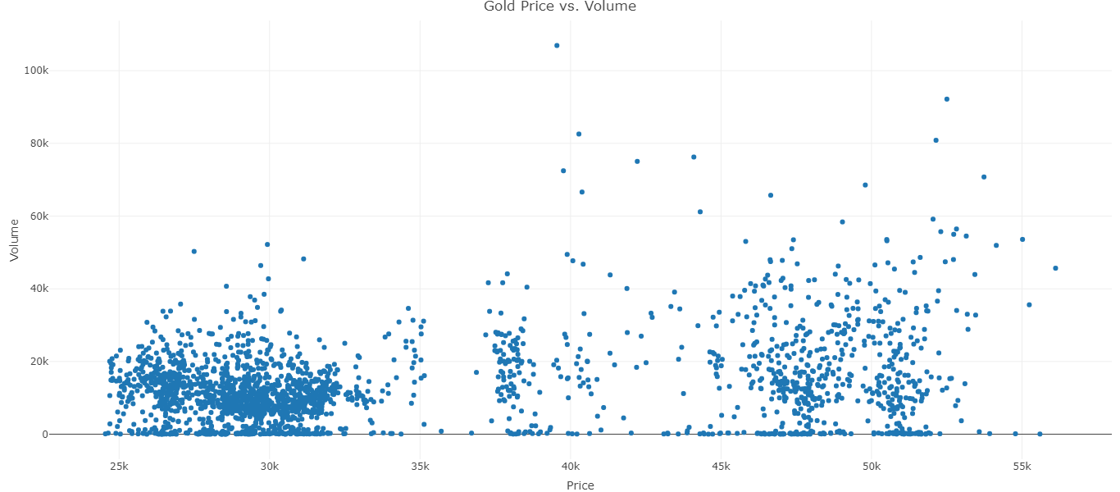
The scatter plot of gold price from 2014 to 2022 indicates that there are two main clusters of data points with high density. The first cluster is located between 25,000 and 35,000, while the second cluster is located between 45,000 and 50,000. These clusters suggest that gold prices have been relatively stable within these ranges over the past eight years

Slide 9
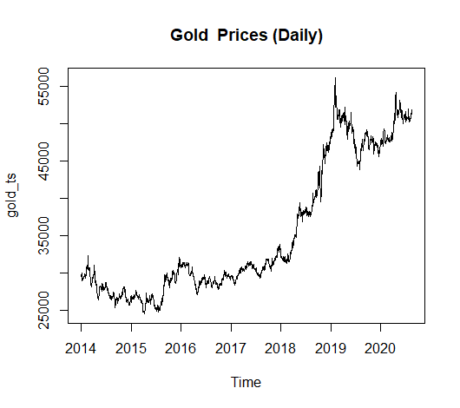
the given graph provides a visual representation of the time series data for gold prices and suggests that there is a long-term increasing trend in the data, as well as some shorter-term seasonal fluctuations

Slide 10
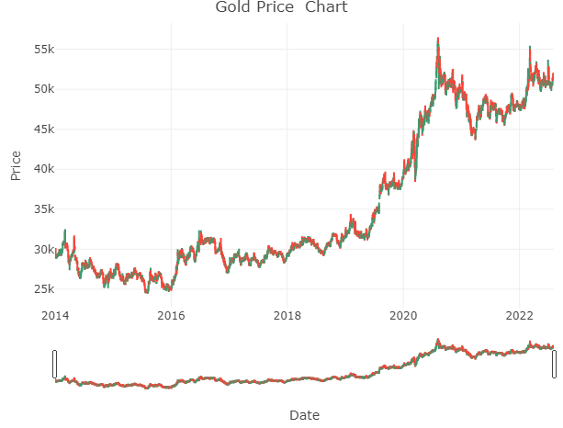
The time series plot of Gold Price on a daily basis shows the daily prices of gold over time, where the x-axis represents the dates, and the y-axis represents the gold prices. Each point on the graph represents the daily price of gold, which is calculated based on the opening price, highest price, lowest price, and closing price for that day. If the closing price is higher than the opening price, the line is green, indicating an upward trend, whereas if the closing price is lower than the opening price, the line is red, indicating a downward trend

Slide 11
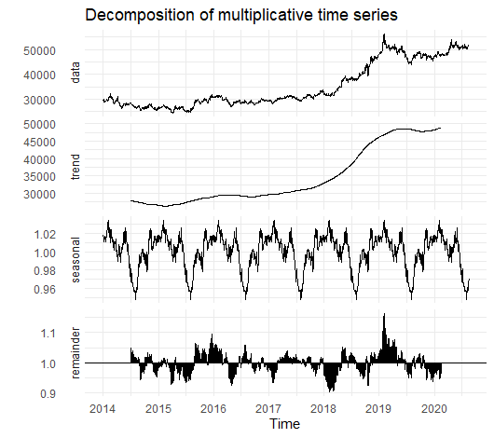
The increasing trend observed in the data suggests that gold prices have been on an upward trajectory over time. This may be due to a variety of factors, including changes in global economic conditions, shifts in investor sentiment, and fluctuations in supply and demand. Understanding this trend is important for predicting future price trends and developing a forecasting model that takes into account the overall upward trend in gold prices.
In addition to the trend, the time series chart also shows a seasonal pattern, indicating that there are recurring patterns in gold prices that occur at regular intervals. This may be due to factors such as changes in demand during certain times of year or shifts in the global economy during specific periods. Identifying and understanding these seasonal patterns is important for predicting future price trends and developing a forecasting model that takes into account these regular fluctuations in gold prices.

Slide 12
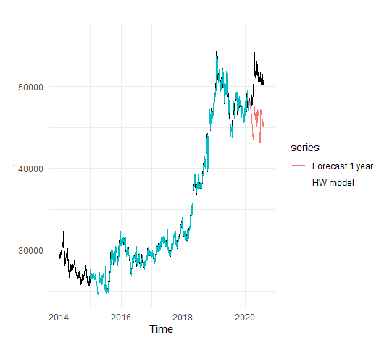
From the graph we can see the blue line (HW model) with train data is quite similar with our original data. Unfortunately, the red line (Forecast) is not really accurate, the forecast predicts the price will going up, but the original data is going down. We will check our error with Mean Absolute Percentage Error (MAPE).
fitted values of the Triple Exponential Smoothing model on the training dataset deviate on average from the actual values by 0.41% .and error for the forecasting is 3.237%

Slide 13
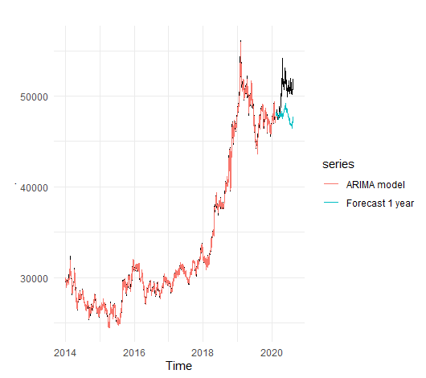
From the graph we can see the red line (ARIMA model) with train data is quite similar with our original data. Unfortunately, the blue line (Forecast) still having deviation from original data. We will check our error with Mean Absolute Percentage Error (MAPE)
fitted values of the ARIMA model on the training dataset deviate on average from the actual values by 0.41%.and the error for forecasting is 2.19%.
The error is slightly lower than Triple Exponential Smoothing model, we will choose this ARIMA model as our final model.

Slide 14
After making prediction, we will evaluate our ARIMA model with assumption check.
No Auto Correlation
H0: residual has no-autocorrelation
H1: residual has autocorrelation.
Box-Ljung test
data: gold_arima_stl$residuals
X-squared = 0.00053748, df = 1, p-value = 0.9815
p-value = 0.9815 > 0.05
residual has no-autocorrelation
Normality of Residuals
H0: residual normally distributed.
H1: residual not normally distributed.
Shapiro-Wilk normality test
data: gold_arima_stl$residuals
W = 0.88148, p-value < 0.00000000000000022
p-value < 0.05 (residual not normally distributed).
Our model fail in Normality of Residuals check.

Slide 15
Interpretation
To sum up our analysis, we have to return to our main objective. We already make model that can predict gold price in 12 months ahead, with forecasting error at 2.197% and still needs improvement in normality of residuals check. As an alternative, we already make another model with Triple Exponential Smoothing Method with forecasting error at 3.237%.

Slide 16
References
1. Singh, J. P., & Pradhan, R. (2015). Forecasting gold prices in India: Application of ARIMA and artificial neural network models. Global Business Review, 16(6), 1157-1173.
2. Tiwari, A. K., & Pradhan, R. (2017). Modelling and forecasting of gold price in India using ARIMA and exponential smoothing models. Resources Policy, 53, 88-102.
3. Mukherjee, S., & Mishra, A. K. (2018). Modelling and forecasting gold prices in India using ARIMA and GARCH models. IIM Kozhikode Society & Management Review, 7(1), 27-35.
4. Chakraborty, S., Chatterjee, D., & Gupta, P. (2020). Forecasting gold prices in India using machine learning algorithms. IIM Kozhikode Society & Management Review, 9(1), 64-80.
5. Mohapatra, S., & Pradhan, R. (2021). A comparative analysis of gold price prediction using time series and machine learning techniques: Empirical evidence from India. Journal of Economic Structures, 10(1), 1-21.
Additional references:
1. Dash, S. K., & Behera, S. K. (2018). Forecasting gold prices in India: An application of univariate time series models. Global Business Review, 19(1), 1-13.
2. Mandal, S. K., & Sahu, S. K. (2019). Forecasting gold prices in India using Box-Jenkins ARIMA models. Journal of Advances in Management Research, 16(3), 342-352.
3. Mishra, S. K., & Kumar, B. (2020). A comparative study of gold price forecasting using ARIMA and neural network models in India. Investment Management and Financial Innovations, 17(2), 313-323.

Slide 17


